Slide 1
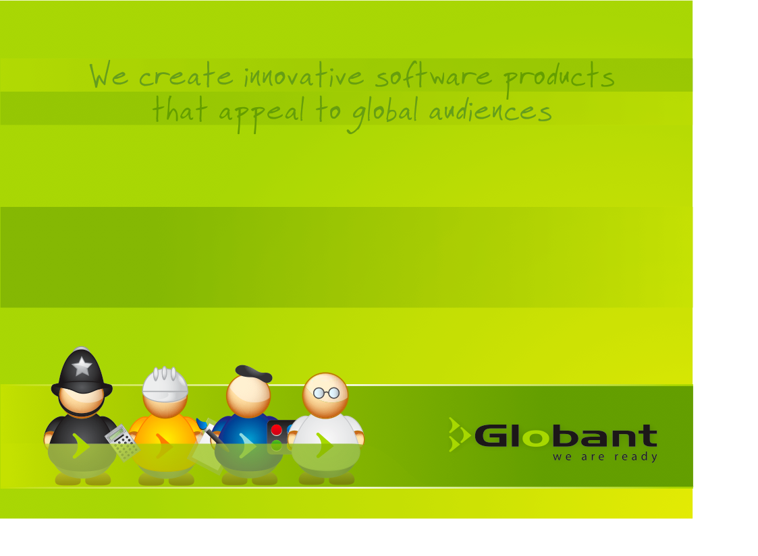
Training – Test Cases

Slide 2
Agenda
Definition
Objetives
Components
What does a TC look like?
TestRail
Use Cases
Design Test Cases from Use Cases
User Stories
Design Test Cases from User Stories
Final Considerations

Slide 3
Definition
A test case is a group of conditions or variables under which we can determine if a system requirement has been partially or completely covered.
It predicts the expected result after having executed a series of steps starting from an initial known state.

Slide 4
Objectives
  Identify and enumerate the conditions to validate
  Define the creation process of a known environment which will allow the system to be exercised (pre-conditions)
  Describe the combinations of data that need to be validated
  Specify the control points
  Define the process of evaluation of the results with respect to:
    The goal of the test (PASS/FAIL)
    The final state of the system (post-conditions)

Slide 5
Components
Test Case ID: A code to identify each test case in a suite
Description: A brief description of the test case’s goal
Pre-Conditions: Description of the state of the system prior to executing the test
Test Inputs: lists the input data to use during the execution
Steps and Observations: each specific action to perform on the system
Control Points: Point where the flow of the system may be altered
Expected Results: The result after the test has been executed
Post-Conditions: Description of the state of the system after executing the test.
Notes:
Test Status : Fail, Pass, cannot run, Ready

Slide 6
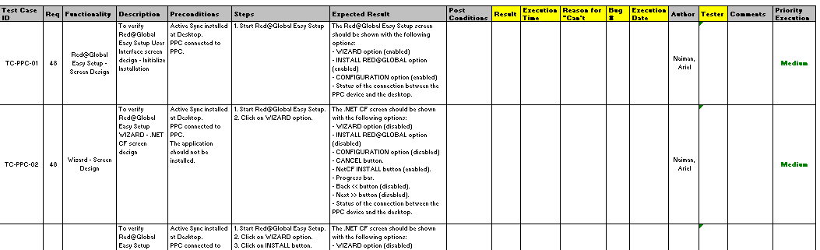
What does a TC look like?
To create Test Cases exists different tools, one example is TestRail. If your organization does not have one, you can use a spreadsheet.

Slide 7
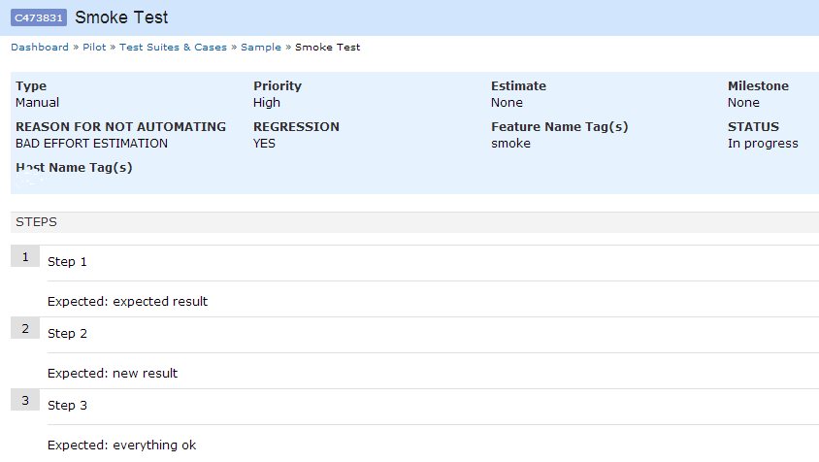
TestRail
TestRail is the manual test case repository and management tool.
A test case in TestRail consists of a description of the test's prerequisites, a list of test steps and the expected result.
In TestRail, test cases are organized into test suites. A test suite is a collection of test cases and is often created for specific project modules or areas.

Slide 8
Use Cases
A Use Case is a description of a sequence of steps which represent interactions between an actor and the system, when the actor uses the system to accomplish a specific task.
An actor is something with a behavior, such as a person (identified by a role), a system or an organization, which interacts in any way with the system. It may or may not be a user.

Slide 9
Use Cases
Relations in Use Cases - The three main relations/associations between use cases are supported by UML standard which describes graphic notations for each.
INCLUSION
EXTENSION
GENERALIZACION

Slide 10
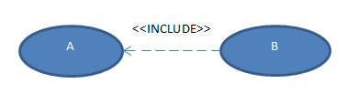
Use Cases (cont.)
Inclusion <<include>> - is an association between use cases where there is a chunk of functionality that is inclusive in multiple cases and can be abstracted into a separate model and essentially "included" in other use cases.

Slide 11

Use Cases (cont.)
Extension <<extend>> - is an association between two use cases where the functionality of some use cases is similar but could have some deviations or additions depending on the scenario.

Slide 12
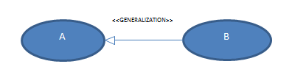
Use Cases (cont.)
Generalization - Generalization is an association between use cases where the basic functionality is the same, but specific implementation details may differ.

Slide 13
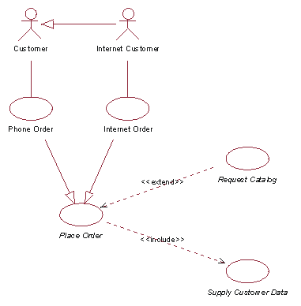
Use Cases (cont.)
Example

Slide 14
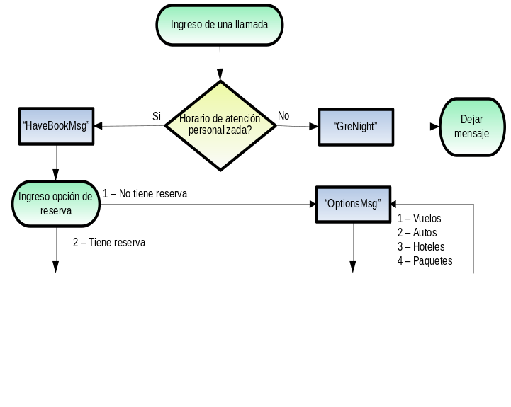
Designing a TC from a UC
Procedure:
Divide the use cases’ functions in testable areas
Identify repetitive tasks
Group and create test data
Write the test cases documenting pre-conditions
Simulate a complete test case execution following all the test cases involved in each use case flow.

Slide 15
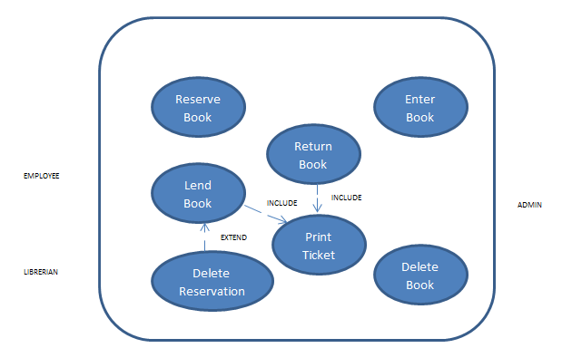

Designing a TC from a UC (cont.)
System Library

Slide 16
Designing a TC from a UC (cont.)
UC ID-Name: LB – Lend Book
Description: The employee can lend a book to a client.
Actors: Employee
Pre-conditions: The client exists and is registered in the system, the book to lend exists and is available.
Post-conditions: A ticket is printed and the status of the book gets updated in the data base to reflect the operation.

Slide 17
Designing a TC from a UC (cont.)
Main Flow:
The employee enters the client’s identification code
The system looks for the client’s information and displays it on the screen together with their reservations if they have any at the time
The employee enters the requested book code or selects the reservation if there is one
The system validates the existence of the book and asks for confirmation of the loan
The employee confirms the operation
The system updates the status of the book in the DB and calls the UC “Print Ticket” and “Delete Reservation” if necessary

Slide 18
Designing a TC from a UC (cont.)
Lets take the first two items and write our first positive test case.
In this case, taking the following information from the main flow:
The employee enters the client’s identification code
The system looks for the client’s information and displays it on the screen together with their reservations if they have any at the time
The following test case is proposed:

Slide 19
Designing a TC from a UC (cont.)
Positive Test Case
ID: 0001
Description: Validate the client search by client identification code.
Preconditions: the user is logged into the application. A client with code 1234 exists in the DB which has at least 1 associated reservation.
Inputs: Client identification code
Steps and observation points:
# | Description | Expected Results
1 | Click on the link Client Search | The search widget is displayed according to mock up usrsearch_01
2 | Enter the client identification code 1234 in the code field and click on the button SEARCH | The search results page is displayed showing the following information: Client data (Identification code, Names, Phone number) and the list of associated reservations.
3 | Execute the following query: SELECT * FROM LIBRARY.RESERVATIONS WHERE CLIENTID=‘1234’ | The number of reservations and their content match those displayed in step 2.

Slide 20
Designing a TC from a UC (cont.)
Control Point: Client identification code entered
Expected Results: The client’s information and reservations are correctly displayed on screen according to the data stored in the data base.
Post-Conditions: The client’s profile is open and ready to perform the next action such as borrow a book or make a new reservation.
Alternative Flow:
2.1. The system doesn’t find the client and displays an error message on screen.
The following negative test case is proposed:
ID: 0002
Description: Validate the error message displayed when a client is not found in the user data base.
Pre-Conditions: the user is logged in the application. No client exists for client identification code 9999 in the user data base.
Inputs: Client identification code

Slide 21
Designing a TC from a UC (cont.)
Steps and observation points:
# | Description | Expected Results
1 | Click on the link Client Search | The search widget is displayed according to mock up usrsearch_01
2 | Enter the client identification code 9999 in the code field and click on the button SEARCH | An error message is displayed on screen indicating that the specified client identification code is not valid. See mock up error_03
3 | Execute the following query: SELECT * FROM LIBRARY.RESERVATIONS WHERE CLIENTID=‘9999’ | The number of rows returned is zero.
Control Point: Client identification code entered
Expected Result: The client information and reservations screen is not displayed when an inexistent client id is entered. An error message is displayed instead.
Post-Conditions: The client id field is displayed again to re-enter the client id code.

Slide 22
User Stories
A user story is one or more sentences in the everyday or business language of the user that captures what a user does or needs to do as part of his or her job function.
It captures the 'who', 'what' and 'why' of a requirement in a simple, concise way.
Main aspects of a user story:
  A description of the story used for planning
  Conversations about the story to discuss its contents and details
  Acceptance Criteria to be able to determine if a story is complete
User stories generally fit the following template:
  "As a <role>, I want <goal/desire> so that <benefit>"

Slide 23
User Stories (cont.)
Six main characteristics are required to write a good user story
Independent – To avoid problems at the time of planning and estimating an iteration
Negotiable – Stories details are negotiated
Valuable – Each story must add value to the business
Estimable – It is necessary that developers/testers be able to estimate stories. To do this the team needs business and technical knowledge and the story can´t be too big.
Small – The size of the story is important at planning time
Testable – Stories must be written in a way that acceptance tests can be defined, this is the only way to validate the story is complete

Slide 24
User Stories (cont.)
Examples:
As a user, I want to search for my customers by their first and last names.
As a non-administrative user, I want to modify my own schedules but not the schedules of other users.
As a user closing the application, I want to be prompted to save if I have made any change in my data since the last save.

Slide 25
Designing a TC from a US
Story – As library administrator I can enter a new book into the system
Mandatory data to be able to enter a new book into the system:
Name – String 30 chars. Only accepts characters
Genre – String 30 chars. Only accepts characters
Author – String 30 chars. Only accepts characters
Editorial – String 30 chars. Only accepts characters
  Entry Date – It is automatically completed with the current date stamp and is non editable
Optional data:
Year of edition – 4 digits
Subjects - String 50 chars. Only accepts characters
Acceptance Criteria:
The system displays the Enter Book screen which includes the fields Date (autocompleted with the current date), Name, Genre, Author, Editorial, Year of Edition and Subjects
A successful operation message is displayed on screen.
The data is registered in the data base table LIBRARY.BOOKS.

Slide 26
Designing a TC from a US
Main Flow:
The administrator enters the menu option Enter Book
The system displays the Enter Book screen which includes the fields Name, Genre, Author, Editorial, Year of Edition and Subjects
The administrator completes the mandatory fields and presses the button “Save”
The system saves the data in the DB including the generated book code
The system shows a “Successful Operation” message, the new generated code and a “Print Label” button
The administrator presses the “Print Label” button and the process which calls the printer is started

Slide 27
Designing a TC from a US (cont.)
Positive Test Case
ID: 0003
Description: Validate the process to enter a new book into the system entering the mandatory data only.
Pre-Conditions: The administrator is logged into the system.
Inputs: Name, Genre, Author, Editorial
Expected Results: The operation is confirmed and a book code is generated
Post-Conditions: The book’s data is saved into the DB table LIBRARY.BOOKS under the assigned book code.

Slide 28
Designing a TC from a US
Steps and observation points:
# | Description | Expected Results
1 | Click on the Enter Book menu option | The system displays the Enter Book screen which includes the fields Date (autocompleted with the current date), Name, Genre, Author, Editorial, Year of Edition and Subjects. See mock up 0002.
2 | Enter Name, Genre, Author and Editorial and press the button “Save”. | A successful operation message is displayed on screen as well as the generated book code and the “Print Label” button. See mock up 0003.
3 | Execute the following query: SELECT * FROM LIBRARY.BOOKS WHERE CODIGO=‘xxxx’ ‘xxxx’ is the newly generated book code. | Verify the data in the data base matches the one entered in step 2.

Slide 29
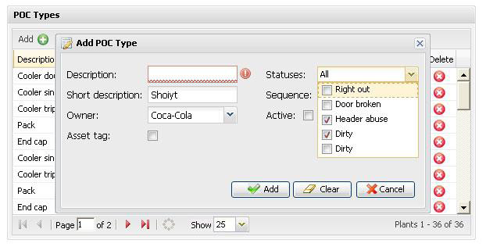
Mock Up
Mock ups allow the testers to visualize the system’s user interface and help them be able to start designing the test cases. Mock ups do not guarantee test cases won’t need to be added, edited or deleted later on.

Slide 30
Final Considerations
Often other types of logic must be covered by test cases other than that included in functional documentation. For example the following for a web application:
  Page not found errors
  Security Problems
  Browser dependent functionality
  Timeouts
  Refresh, Back and Forward browser buttons use
  Cookies

Slide 31
Final Considerations (cont.)
Assume someone other than you will be executing your test cases
The level of detail in the test cases must match the acceptance criteria of the client previously approved.
Test cases should be short and easy to follow
Every click must be documented
Don’t leave anything to chance
Use bullets to distinguish tasks or steps
Use correct names to reference menus, screens, options, buttons etc.
Follow the same criteria for all your test cases
Make certain texts, like buttons, links or screen names, stand out by using capital letters, bold or underlined text.

